Slide 1
Predictive Analytics for e-Commerce

Slide 2
What are we going to learn today ?
At the end of this session, you will be able to know:
What is Predictive Analytics
Applications for Predictive Analytics
How organizations are using Predictive Analytics
Tools used for Predictive Analytics
Use of Predictive Analytics in eCommerce
Hands on - Designing a Predictive Model

Slide 3
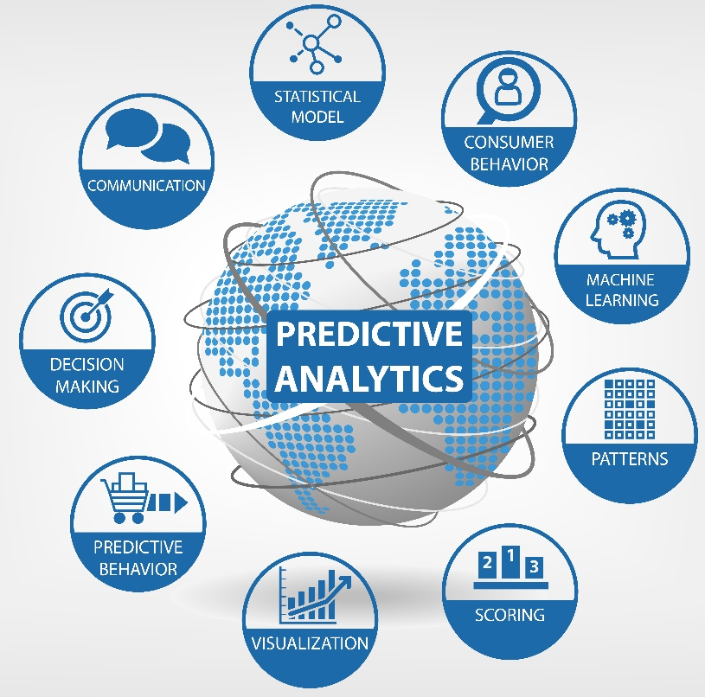
Predictive Analytics
Predictive analytics is the analysis of data by using statistical algorithms and machine-learning techniques to identify the likelihood of future outcomes based on historical data

Slide 4
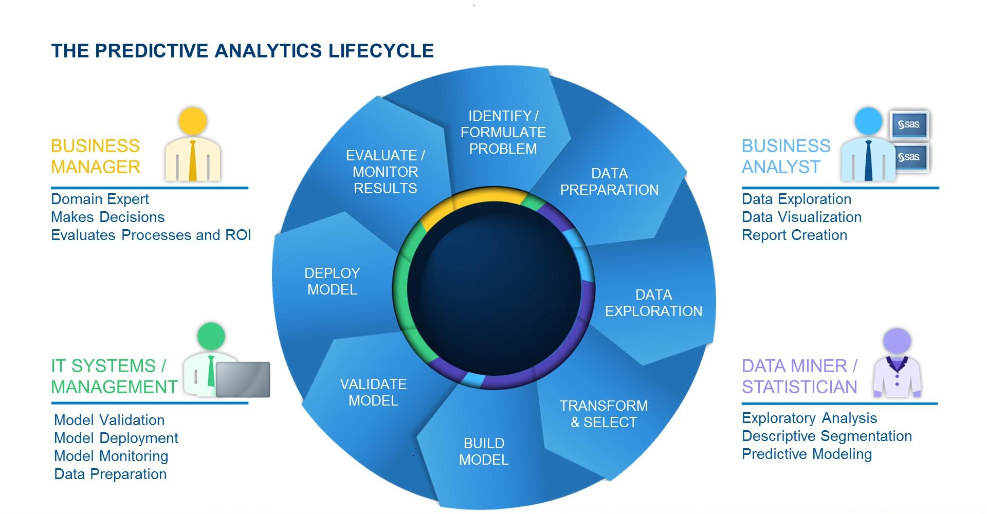
Predictive Analytics Lifecycle
Source: blogs.sas.com

Slide 5
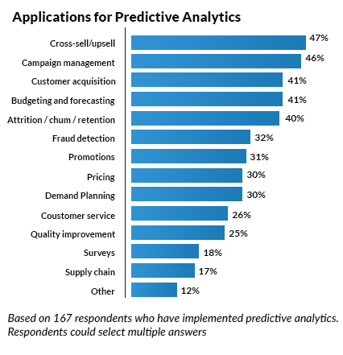
Applications for Predictive Analytics
Source: www.academia.edu

Slide 6




Real-Life Examples
Commonwealth Bank can reliably predict the likelihood of fraud activity for any given transaction before it is authorized – within 40 milliseconds of the transaction being initiated
Lenovo achieved 50% reduction in issue detection time
Salt River Project forecasting model helps them to know the best time to sell excess electricity for the best price
Staples analyzes online and offline consumer behavior to provide a complete picture of their customers and realized a 137% ROI
Source: www.academia.edu

Slide 7
Thoughtful Predictive Analytics
Thoughtful Predictive Analytics ?

Slide 8

Which Path to Follow

Slide 9







Predictive Analytics Tools & Softwares

Slide 10
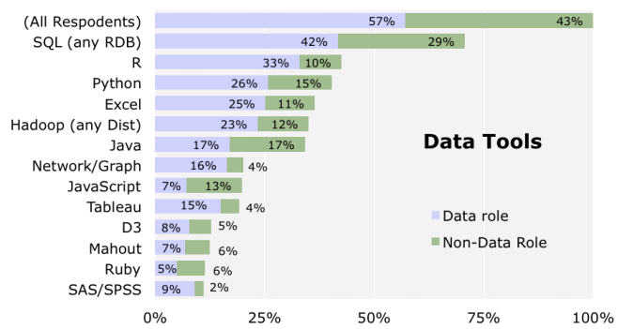
Why R ?
Tool usage comparison
http://www.oreilly.com/data/free/files/stratasurvey.pdf

Slide 11
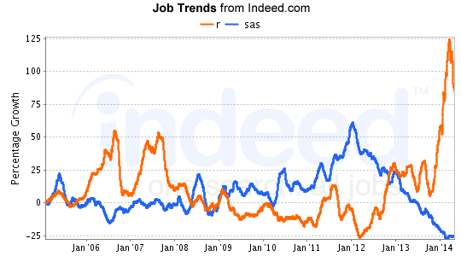
Why R ?
“R has really become the second language for people coming out of grad school now, and there’s an amazing amount of code being written for it,” said
Max Kuhn,
Associate Director of Statistics,
Pfizer
Comparing R and SAS
http://r4stats.com/articles/popularity/

Slide 12
Most heated debate- R or Python
Python is a generic programming language and it is great at that. But it is not specifically for data analysis
Following points make it clear why to choose R for Data analysis than Python :
R was specifically designed for Data Analysis
The user base for R as a statistics language is gigantic compared to any other language
R has more advanced statistical functionality than Python
R has better visualization capabilities than Python
R has a better cross platform compatibility than Python

Slide 13
Predictive Analytics for e-Commerce

Slide 14

Predictive Analytics for e-Commerce
eCommerce and online retailers are perfect fit for use of predictive analytics. Predictive analytics can serve following purposes for eCommerce
Predictive Search
Recommendations
Pricing Management
Supply Chain Management
Business Intelligence

Slide 15
Predictive Analytics for e-Commerce
All eCommerce giants are in race for increasing their customer base. Increasing the customer base is a two step process :
Attracting more users (visitors)
Converting visitors into customers
This leads to two questions
Who will visit/revisit the website in next couple of days ?
Who are likely to buy ?

Slide 16
Predictive Analytics – Who is likely to buy
Some users are more likely to buy when compared to others
Following parameters can help, to find out users who are more likely to buy
Visit Count
Average time spent on website
Days since last visit
Page Views

Slide 17
Collecting and Preparing the data
To build a predictive model we will require the data, which can be achieved from many different places one of which is Google Analytics
Google Analytics can be used to provide following data
Visitor Id
Visitor Type
Visit Count
Landing Page
Exit Page
Average time spent on website
Page views
Unique page views
Days since last visit
Medium (organic search or direct)

Slide 18

Designing the Predictive Model
Code Demo

Slide 19
Thank You …
Questions/Queries/Feedback
Recording and presentation will be made available to you within 24 hours

